Slide 1
Energy Storage Systems - Chemical and 3D Solar Cell

Slide 2
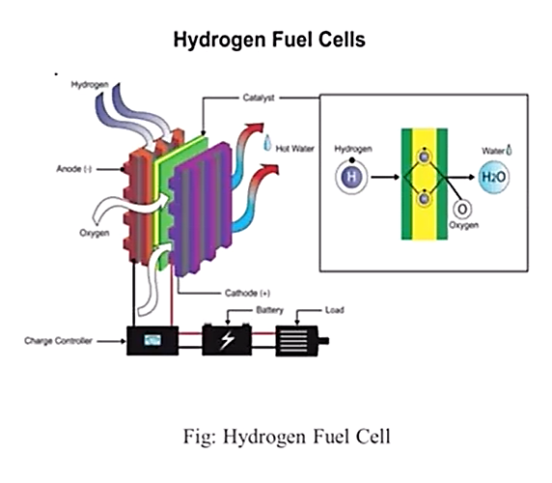
Energy Storage Systems - Chemical
Chemical:
Chemical storage stores energy in a chemical which are in form of gases, liquid or solid and releases that energy through chemical reactions.
Hydrogen Fuel Cells:
Hydrogen is a clean fuel that, when consumed in a fuel cell, produces only water.
Hydrogen can be produced from a variety of domestic resources, such as natural gas, nuclear power, biomass, and renewable power like solar and wind.
These qualities make it an attractive fuel option for transportation and electricity generation applications.
It can be used in cars, in houses, for portable power, and in
many more applications.
The chemical energy of hydrogen fuel and oxygen into electricity through a pair of redox reactions.

Slide 3
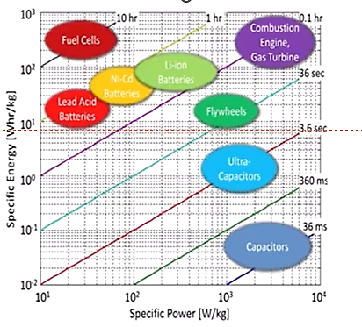
Energy Storage Systems - Chemical
Fuel cells are different from most batteries in requiring a continuous source of fuel and oxygen (usually from air) to sustain the chemical reaction,
whereas in a battery the chemical energy usually comes from metals and their ions or oxides that are commonly already present in the battery, except in flow batteries.
Fuel cells can produce electricity continuously for as long as fuel and oxygen are supplied. Hydrogen has an energy density of approximately 120 MJ/kg, almost three times more than diesel or gasoline.
In electrical terms, the energy density of hydrogen is equal to 33.6 kWh of usable energy per kg, versus diesel which only holds about 12-14 kWh per kg.
Fig: Ragone plot of the most important
energy storage systems

Slide 4
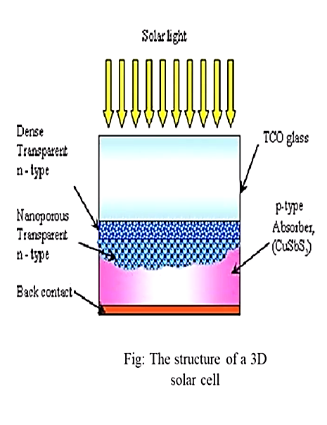
Solar Based Renewable Energy Systems
3D Solar Cell:
Three-dimensional solar cells that capture nearly all of the light that strikes them and could boost the efficiency of photovoltaic systems while reducing their size, weight and mechanical complexity.
The new 3D solar cells, created at the Georgia Tech Research Institute, capture photons from sunlight using an array of miniature "tower" structures that resemble high-rise buildings in a city street grid.
The cells could find near-term applications for powering spacecraft, and by enabling efficiency improvements in photovoltaic coating materials, could also change the way solar cells are designed for a broad range of applications.

Slide 5
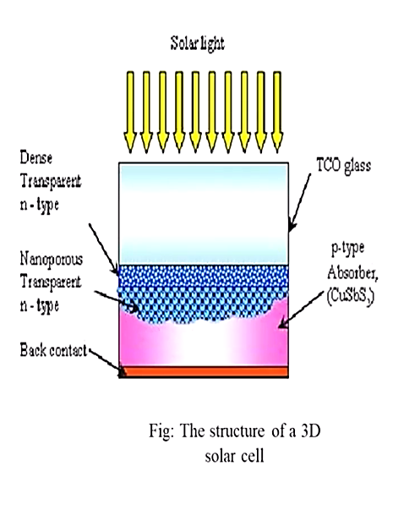
Solar Based Renewable Energy Systems
• The 3D design was described in the March 2007 issue of the journal JOM, published by The Minerals, Metals and Materials Society.
• The research has been sponsored by the Air Force Office of Scientific Research, the Air Force Research Laboratory, NewCyte Inc., and Intellectual Property Partners, LLC.
• A global patent application has been filed for the technology. Solar3D, Inc. plans to commercialize such 3D cells, but its technology is currently patent-pending.

Slide 6
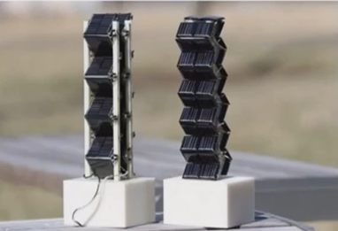
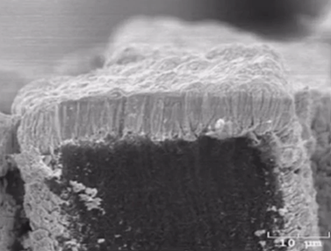
Solar Based Renewable Energy Solar Systems
The tower structures can trap and absorb light received from many different angles, the new cells remain efficient even when the sun is not directly overhead.
That could allow them to be used on spacecraft without the mechanical aiming systems that maintain a constant orientation to the sun, reducing weight and complexity - and improving reliability.
Fig: Cross section image shows cadmium telluride coating around

Slide 7
Solar Based Renewable Energy Solar Systems
In the finished cells, the carbon nanotube arrays serve both as support for the 3D arrays and as a conductor connecting the photovoltaic materials to the silicon wafer.
The researchers chose to make their prototypes cells from the cadmium materials because they were familiar with them from other research.
However, a broad range of other photovoltaic materials could also be used, and selecting the best material for specific applications will be a goal of future research
Fig: Cross section image shows cadmium telluride coating around

Slide 8
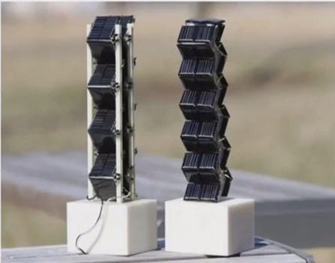
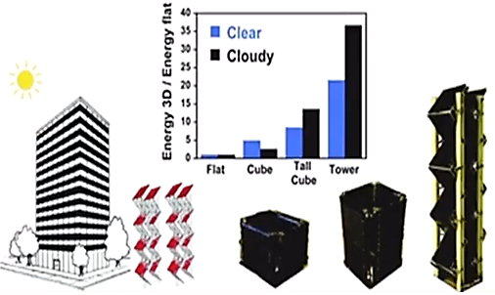
Solar Based Renewable Energy Solar Systems
Fabrication of the cells begins with a silicon wafer, which can also serve as the solar cell's bottom junction.
The researchers first coat the wafer with a thin layer of iron using a photolithography process that can create a wide variety of patterns.
The patterned wafer is then placed into a furnace heated to 780 degrees Celsius. Hydrocarbon gases are then flowed into furnace, where the carbon and hydrogen separate.
In a process known as chemical vapor deposition, the carbon grows arrays of multi-walled carbon nanotubes a top the iron patterns.

